Slide 1
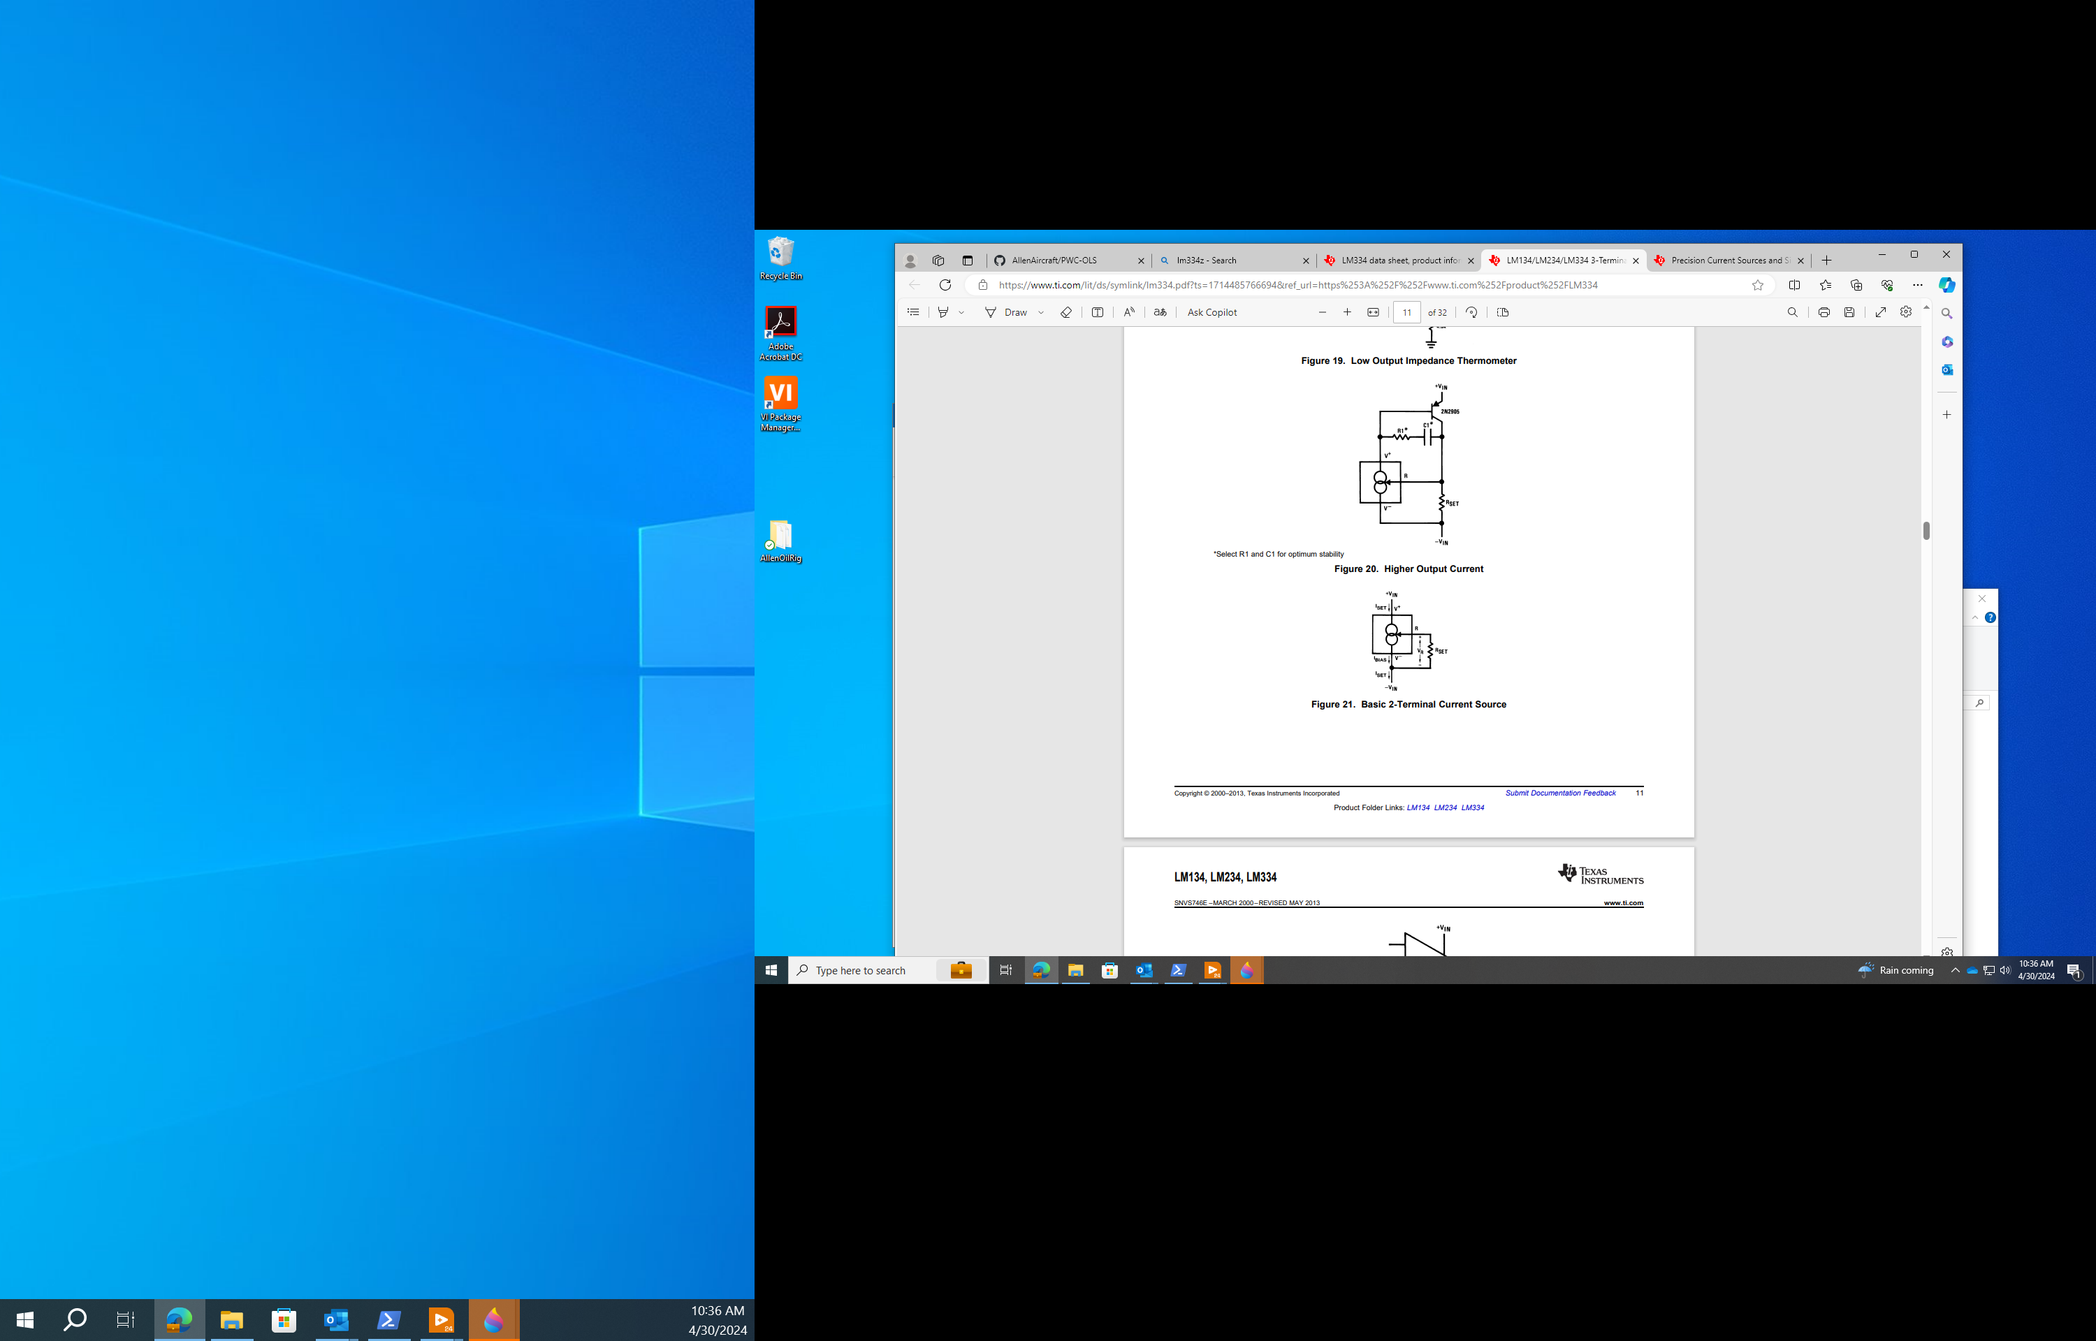



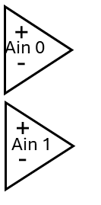

24Vdc
SMPS
24Vdc
Instrument
Power
Interface PCB
Custom Unit
Connector
Left
Right
Motor
Controller
Pololu
18V7
14ma
I-source
x8
Buffer/
Scaler
x8
Pump
4A DC Motor
+5Vdc
USB Hub
Laser
Keyance
LG-K
DUT
Sensor
x4
LV Win11
Workstation
DataQ
DI-2108

Slide 2
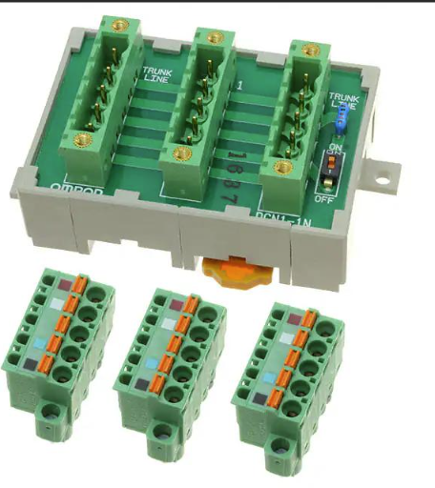
24Vdc
SMPS
24Vdc
Instrument
Power
Interface PCB
Custom Unit
Connector
TANK
To Laser
14ma
I-source
x8
Left
Right
Pump
4A DC Motor
Motor
Controller
Pololu
18V7
Buffer/
Scaler
x8
DUT
Sensor
x4
CONNECTOR EXAMPLE
USB Hub
Laser
=
Keyance
LK-G2000
LV Win11
Workstation
DataQ
DI-2108
NOT TO SCALE

Slide 3
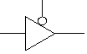
Tri-state
Buffer
Motor
Controller
x4
On/Off
Fwd/Rev
Left
Right
+5Vdc
Do-6
-
+
Ain 0
Do-5
-
+
Do-4
Ain 1
DUT
Sensor
x4
DataQ
DI-2108

